Slide 1
TEAM
Vignesh.S
Prassanna Ganesan
Syed Fardeen Althaf S.K
Sree Murari

Slide 2
Nalaiya Thiran
Efficient Water Quality Analysis & Prediction Using Machine Learning

Slide 3
Intro
Water is considered as a vital resource that affects various aspects of human health and lives. The quality of water is a major concern for people living in urban areas. The quality of water serves as a powerful environmental determinant and a foundation for the prevention and control of waterborne diseases. However predicting the urban water quality is a challenging task since the water quality varies in urban spaces non-linearly and depends on multiple factors, such as meteorology, water usage patterns, and land uses, so this project aims at building a Machine Learning (ML) model to Predict Water Quality by considering all water quality standard indicators.

Slide 4
Literature Survey
https://www.atlantis-press.com/journals/hcis/125965714/view
https://www.datascience2000.in/2021/10/water-quality-prediction-using-machine.html
RESEARCH BASED ON OUR PROJECT
Cloud architecture patterns:Develop cloud native applications by BILL WILDER

Slide 5
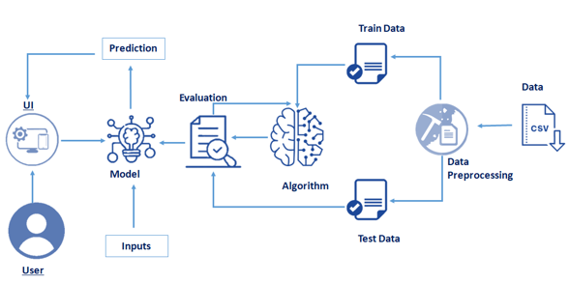
PROPOSED SOLUTION

Slide 6
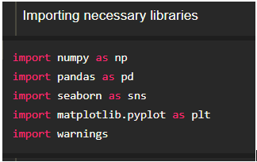
IMPORTING THE LIBRARIES
It is important to import all the necessary libraries such as pandas, numpy, matplotlib.
Numpy- It is an open-source numerical Python library. It contains a multi-dimensional array and matrix data structures. It can be used to perform mathematical operations on arrays such as trigonometric, statistical, and algebraic routines.
Pandas- It is a fast, powerful, flexible, and easy to use open-source data analysis and manipulation tool, built on top of the Python programming language.
Seaborn- Seaborn is a Python data visualization library based on matplotlib. It provides a high-level interface for drawing attractive and informative statistical graphics.
Matplotlib- Visualisation with python. It is a comprehensive library for creating static, animated, and interactive visualizations in Python

Slide 7
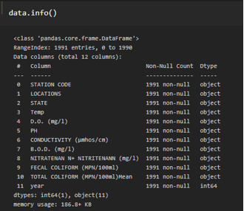
WORKFLOW 1
Analyse The Data
Data Visualization
Data visualization is where a given dataset is presented in a graphical format. It helps the detection of patterns, trends and correlations that might go undetected in text-based data. Understanding your data and the relationship present within it is just as important as any algorithm used to train your machine learning model. Machine learning models will perform poorly on data that wasn’t visualized and understood properly.
To visualize the dataset we need libraries called Matplotlib and Seaborn. The Matplotlib library is a Python 2D plotting library that allows you to generate plots, scatter plots, histograms, bar charts etc.
Please refer to the link given to know about the data visualization

Slide 8
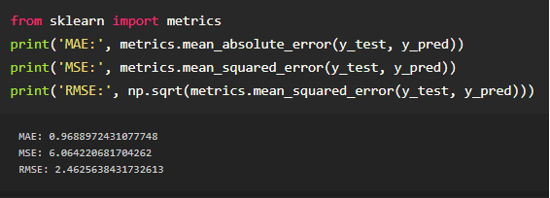
WORKFLOW 2
Model Building
Finally, we need to check to see how well our model is performing on the test data.
You can refer to the link provided to know more about evaluation metrics for regression problems
We calculated the values for Root mean square error, Mean Square Error, mean absolute error for our model .

Slide 9
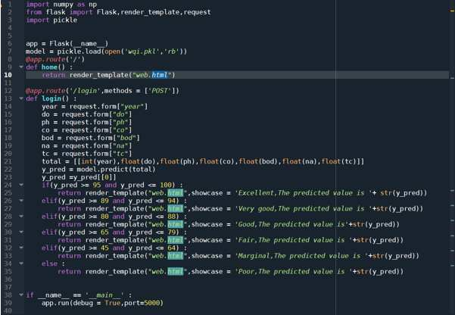
WORKFLOW 3
Application Building
In this section, we will be building a web application that is integrated to the model we built. A UI is provided for the uses where he has to enter the values for predictions. The enter values are given to the saved model and prediction is showcased on the UI.
This section has the following tasks
Building HTML Pages
Building server-side script

Slide 10
THANK YOU
–-Team

